Slide 1

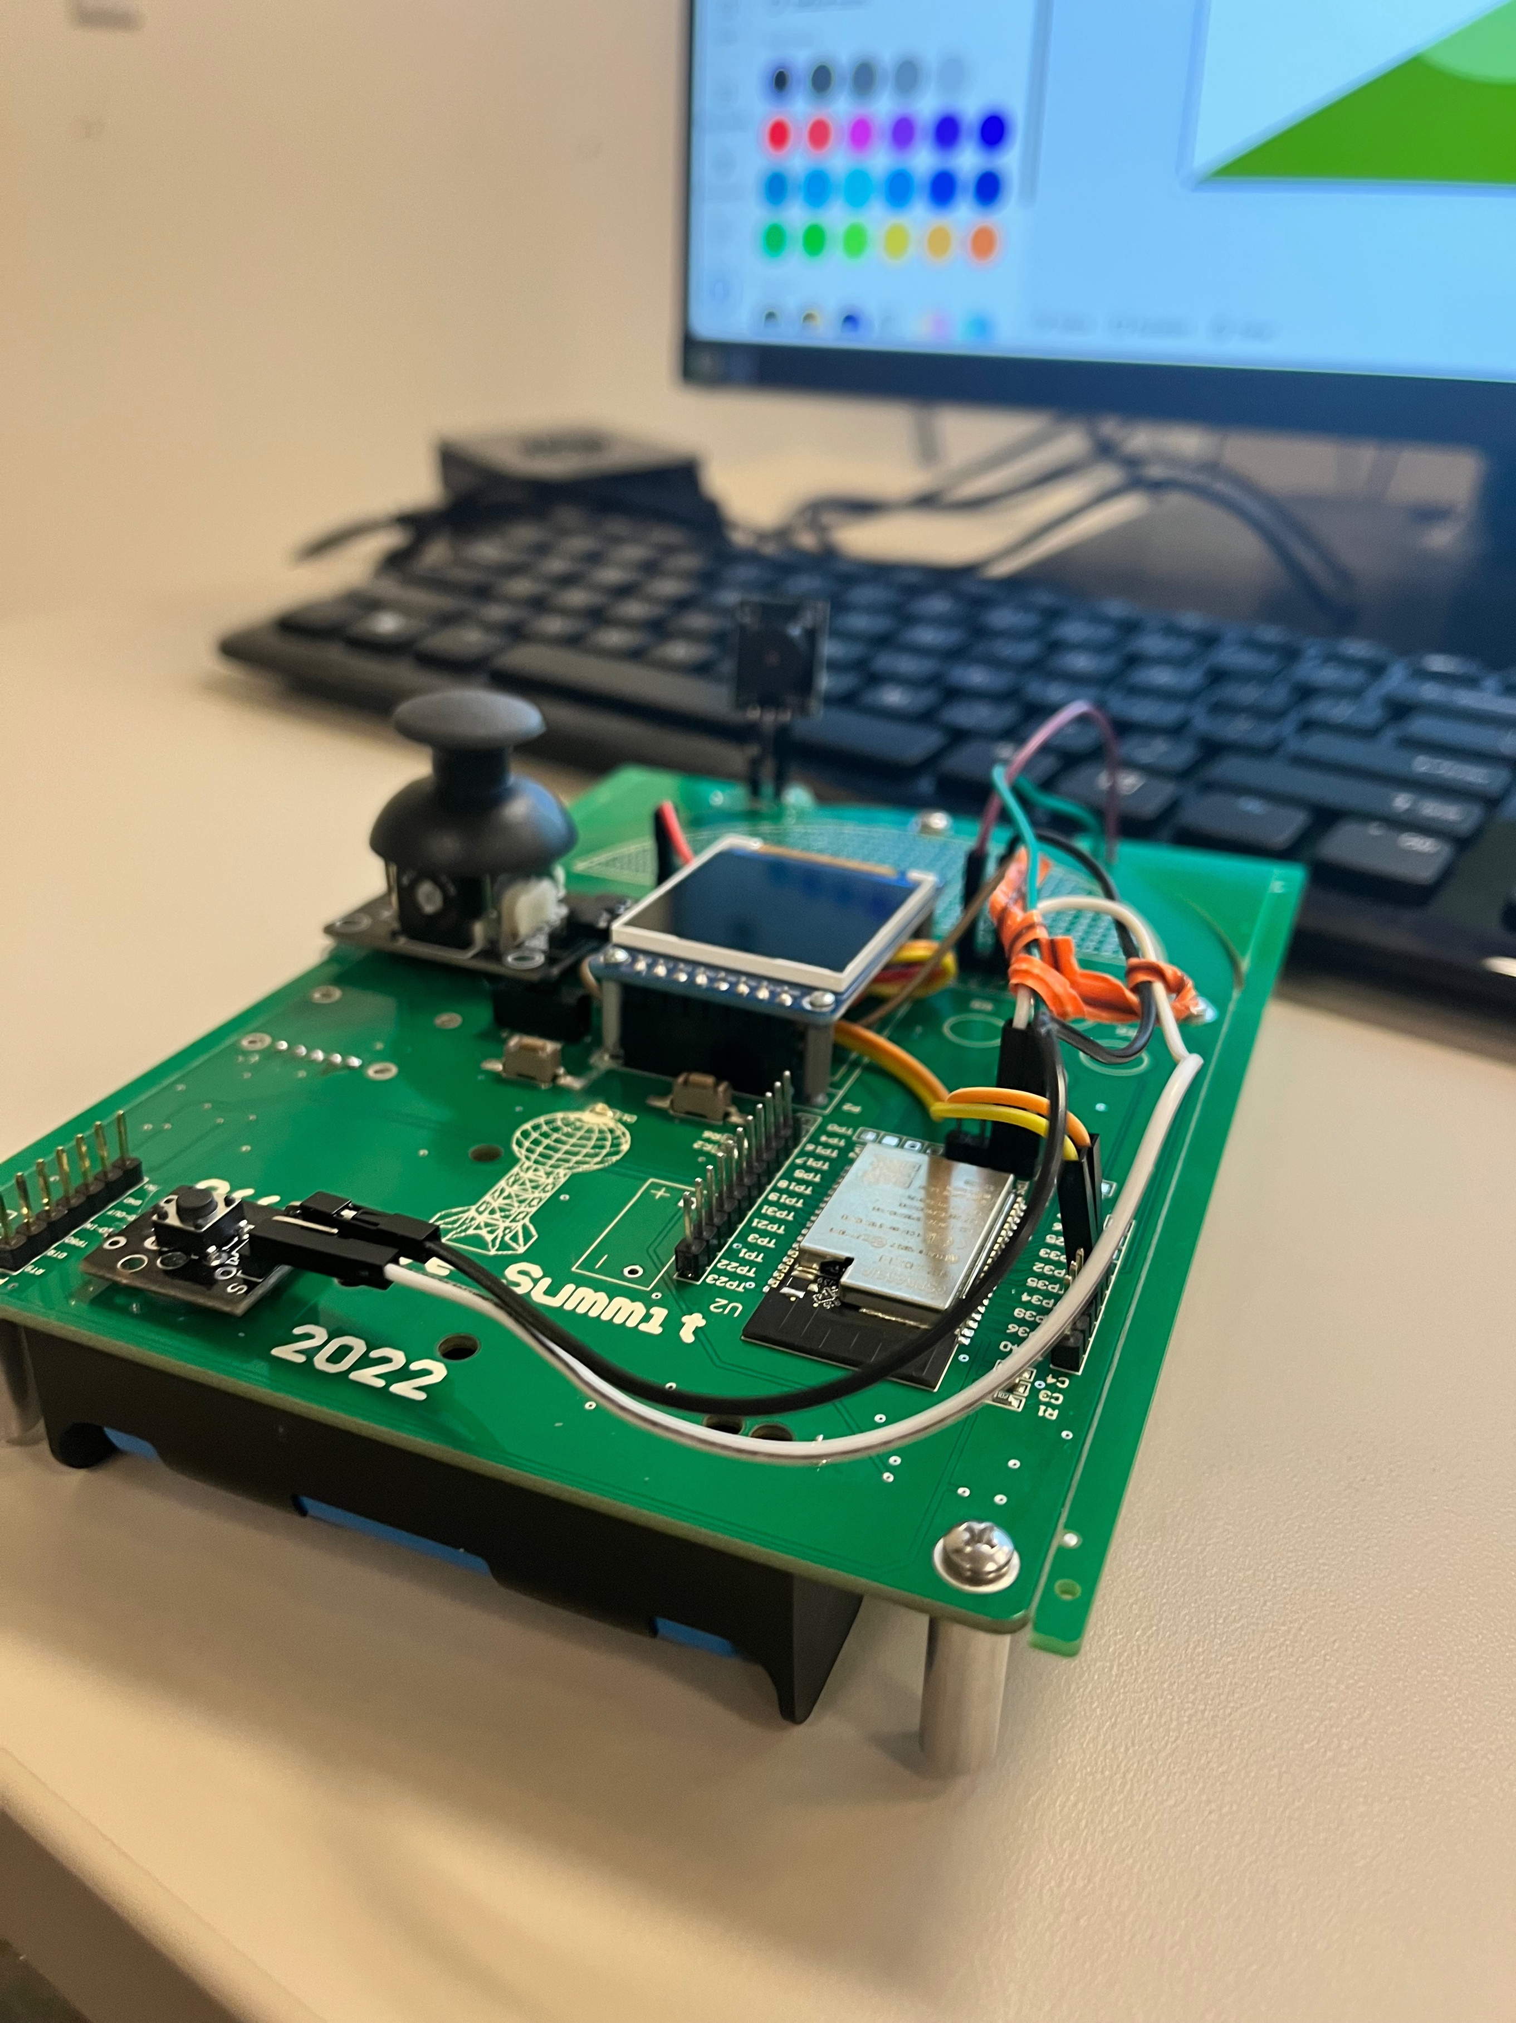

Slide 2
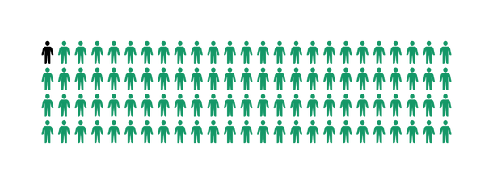
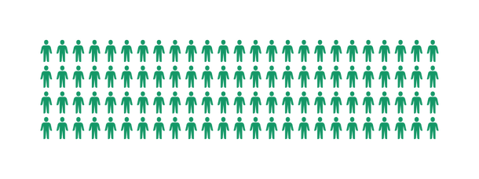
Why?
Fewer than 1 in 1000 Americans
Notes:
Highlight the need for morse as so few people understand it even though its so commonly used in aviation, maritime (naval) uses, and military uses. Then say, "So how do we fix this?"

Slide 3
Introducing: Morse Code Translator Device
For fast, easy, and portable morse code

Slide 4
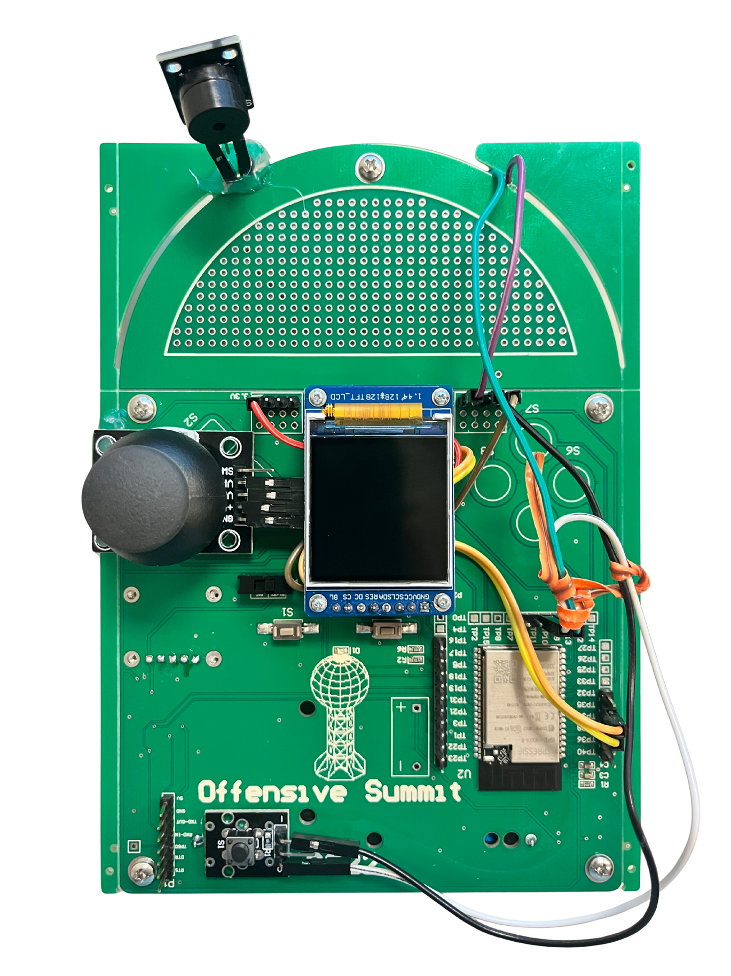
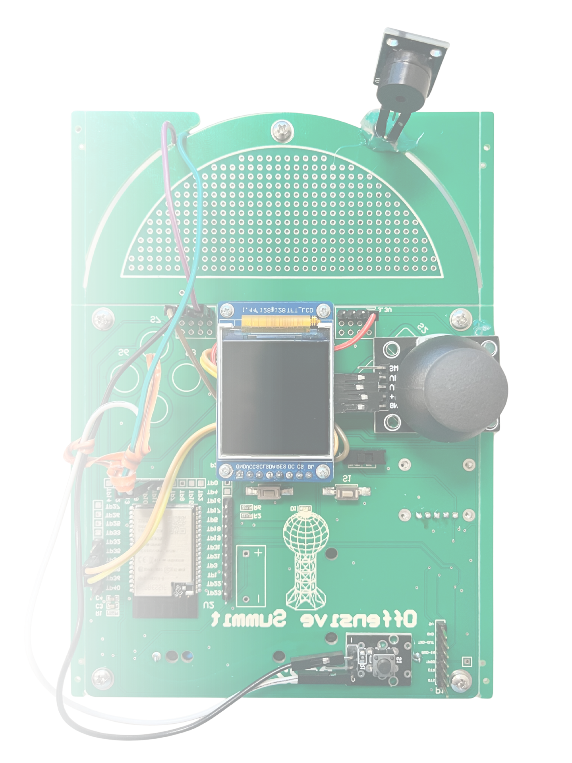
Device Overhead
Notes:
Point out key features

Slide 5
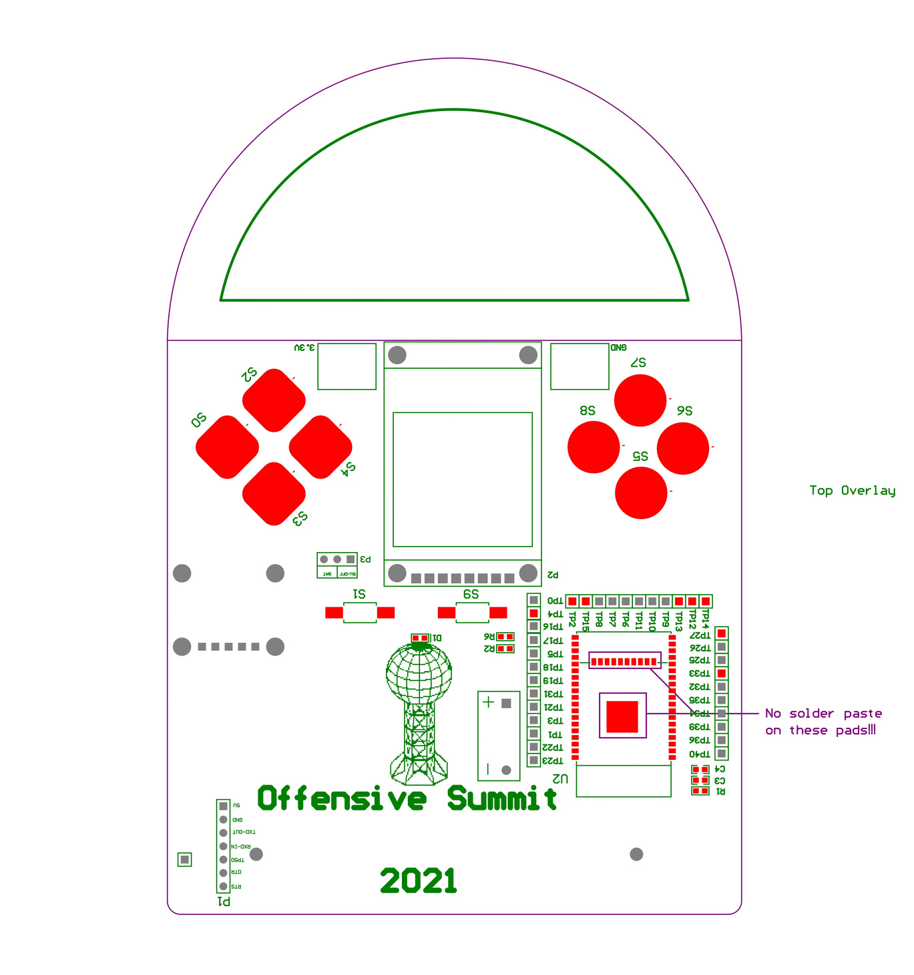
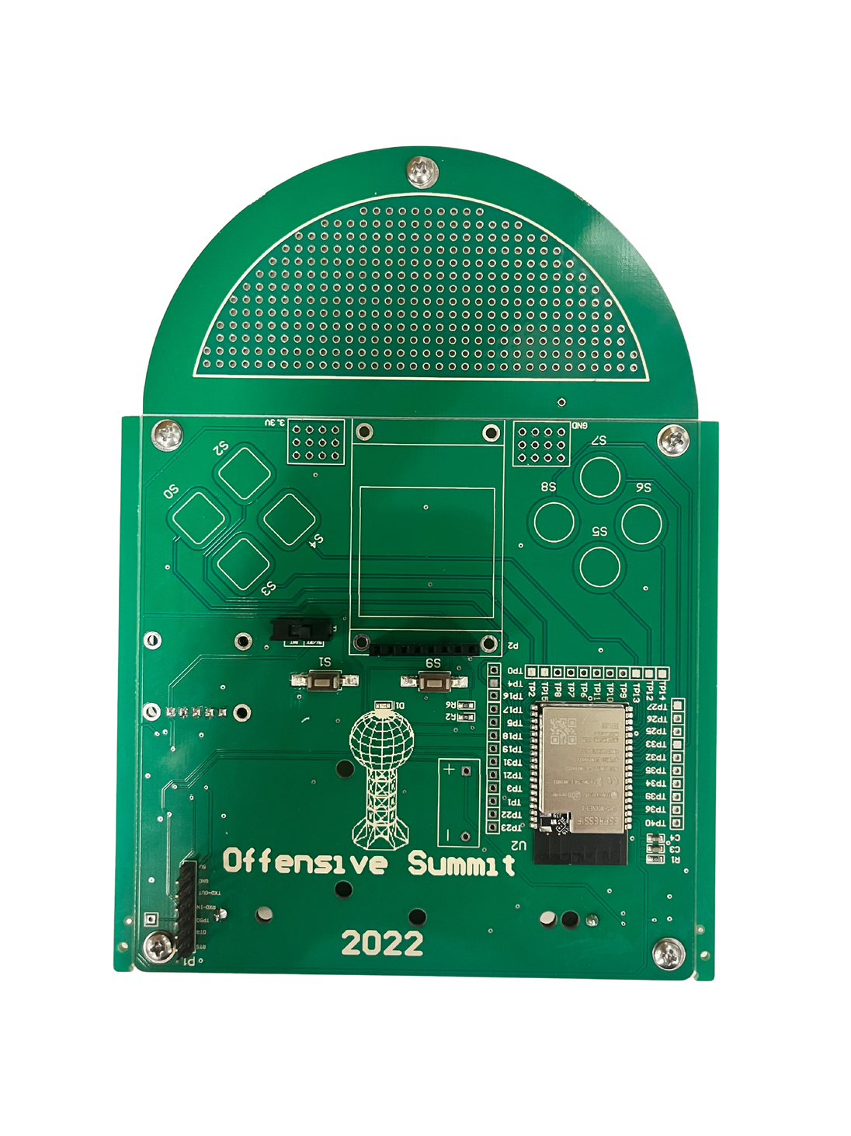
Component List
2022 Offensive Summit Badge
Notes:
Note the parts that come with it: USB-C Module, capacitive touch, and LED

Slide 6
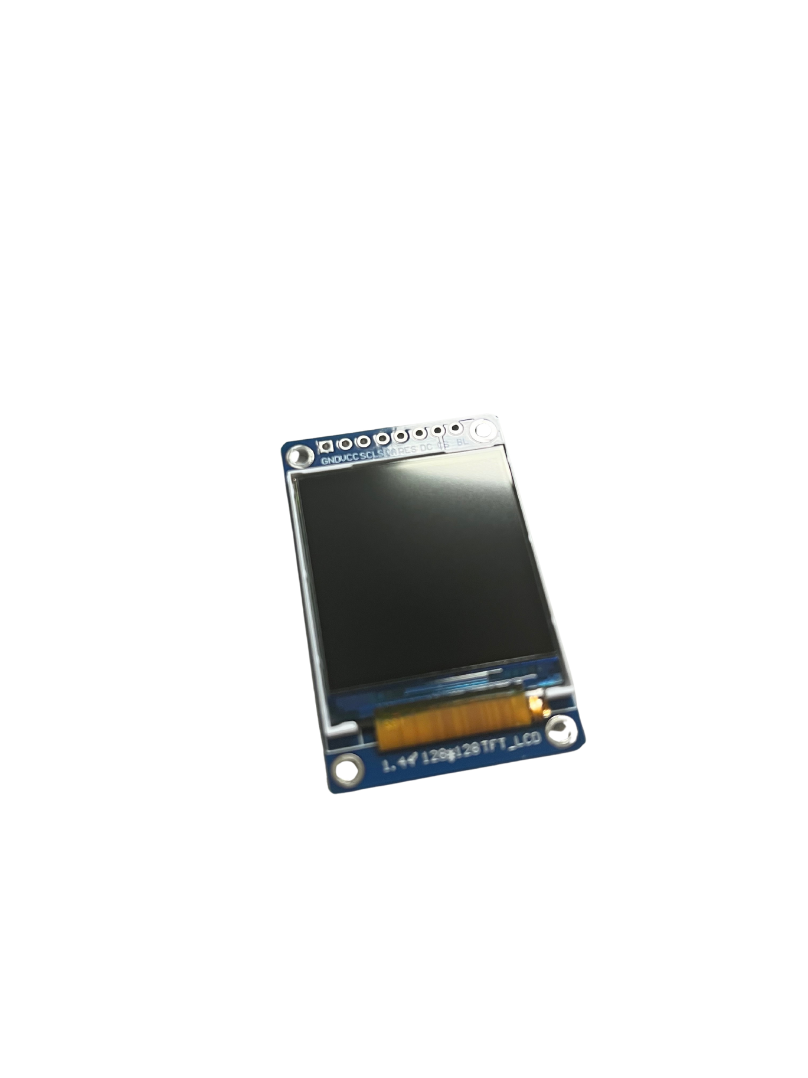
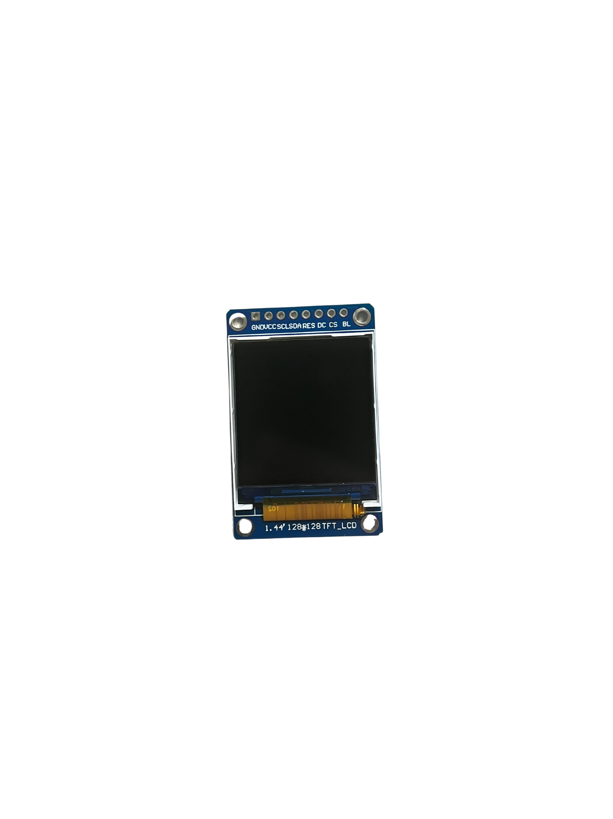
Component List
128x128 LCD

Slide 7
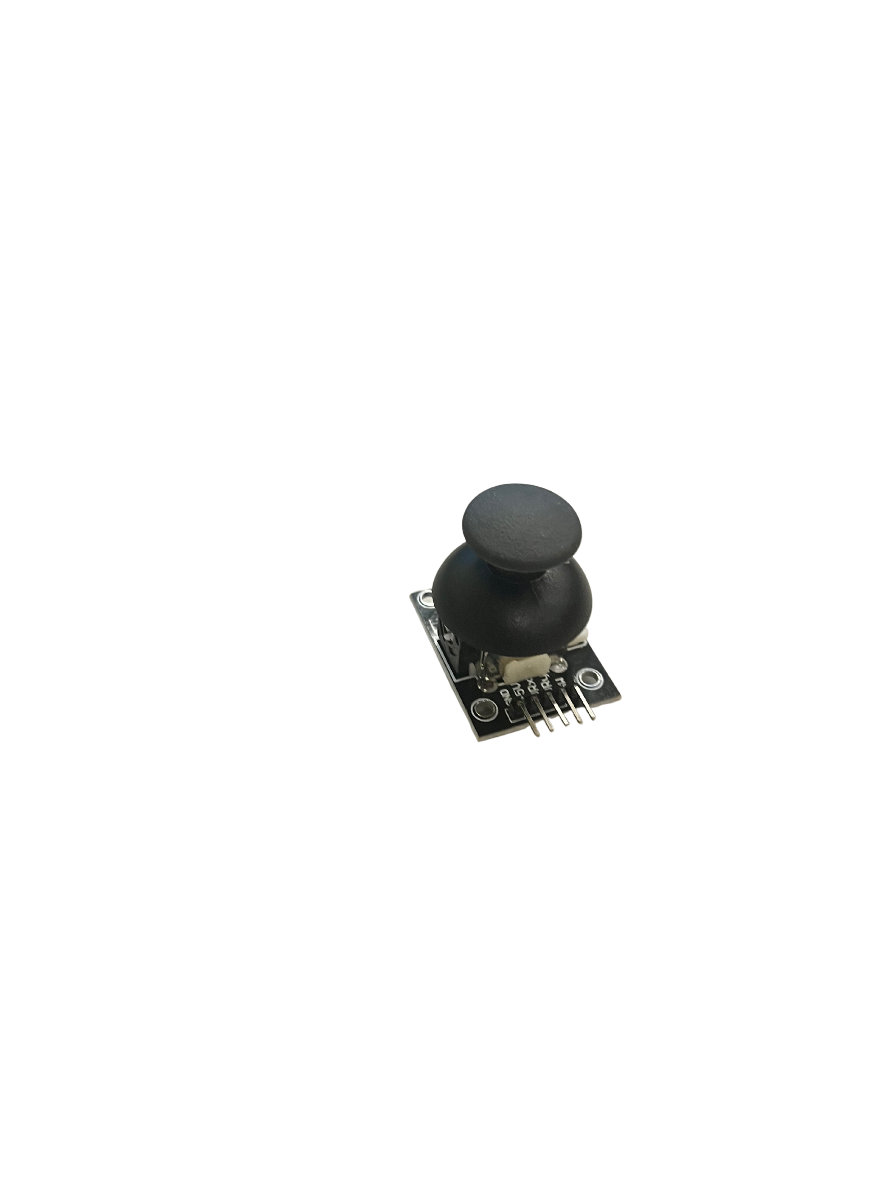
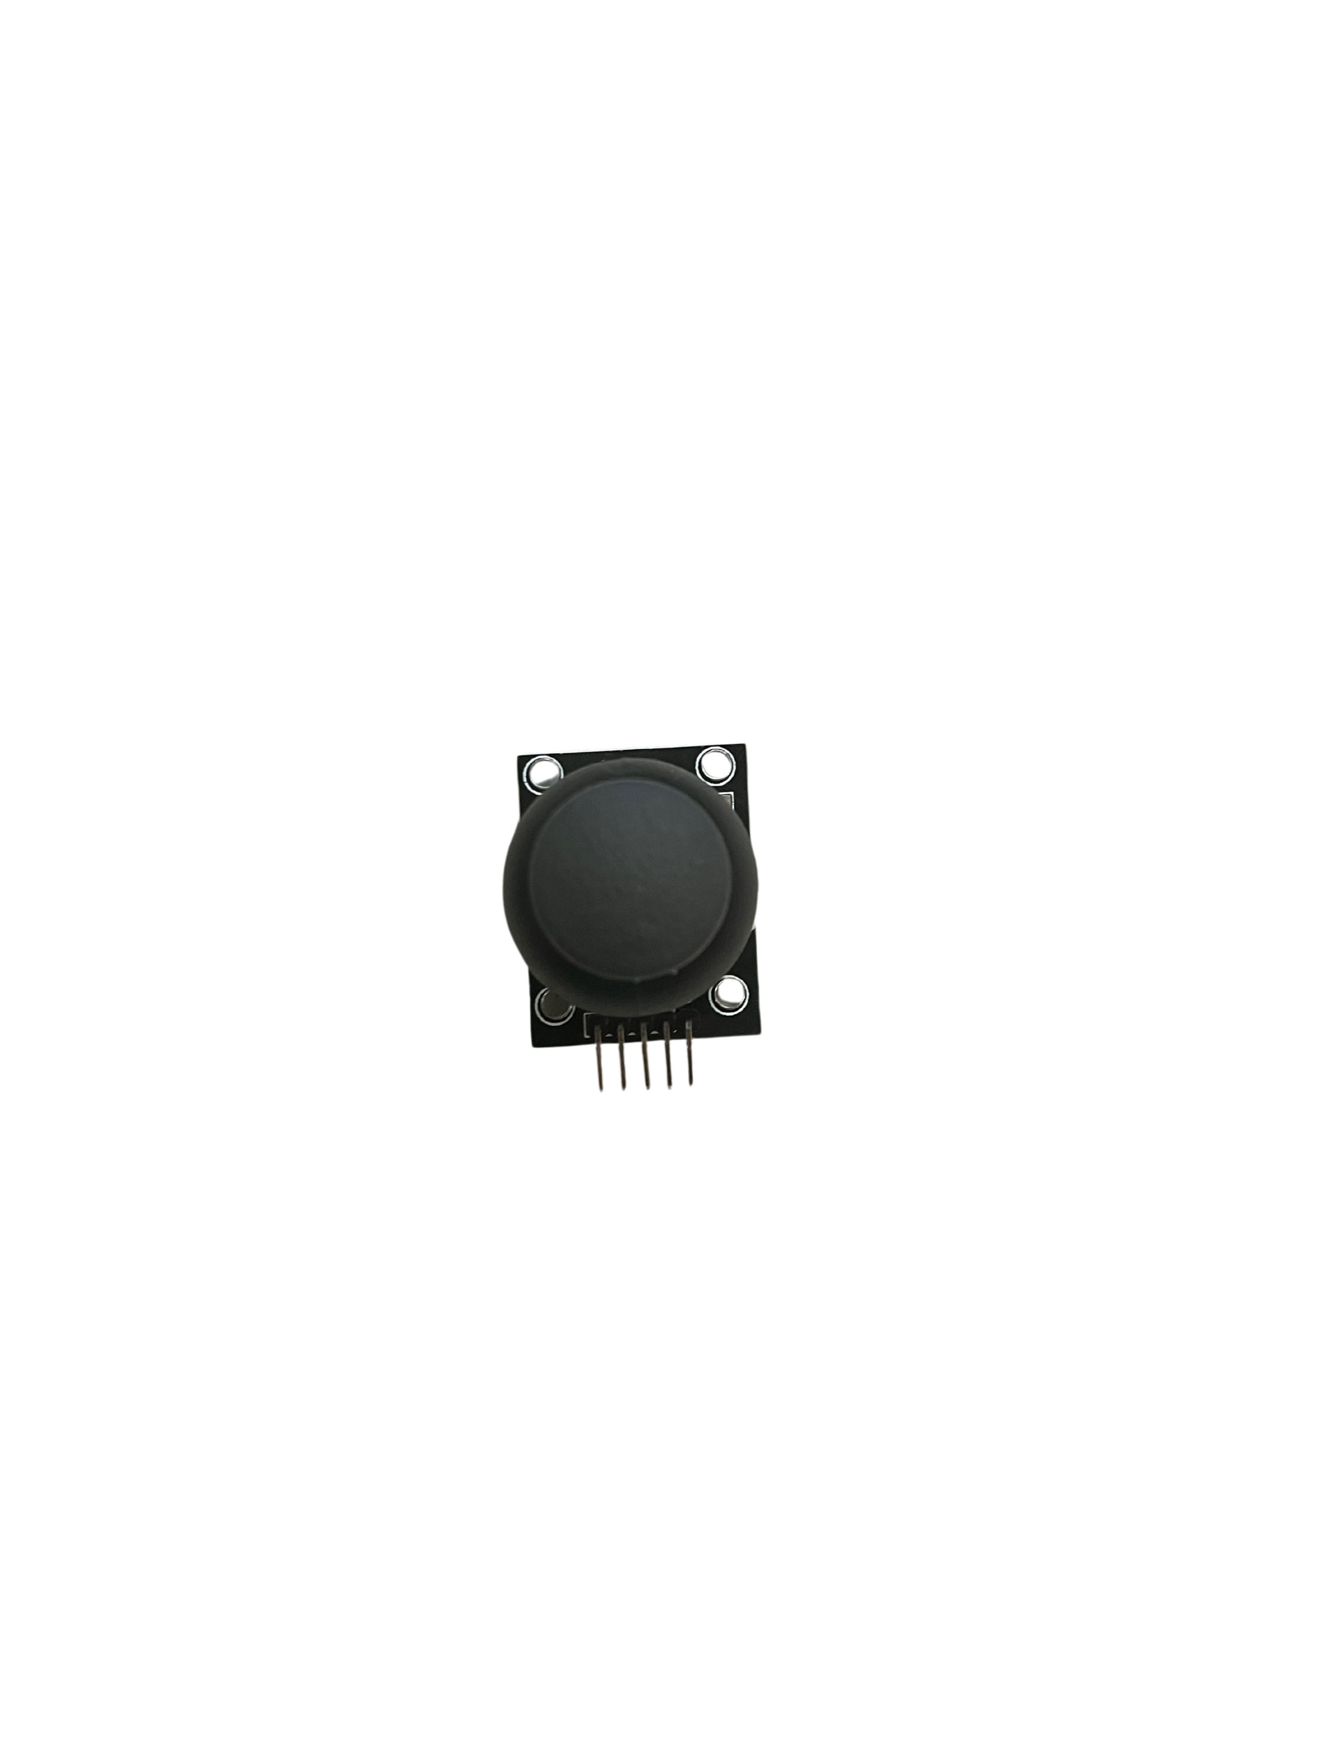
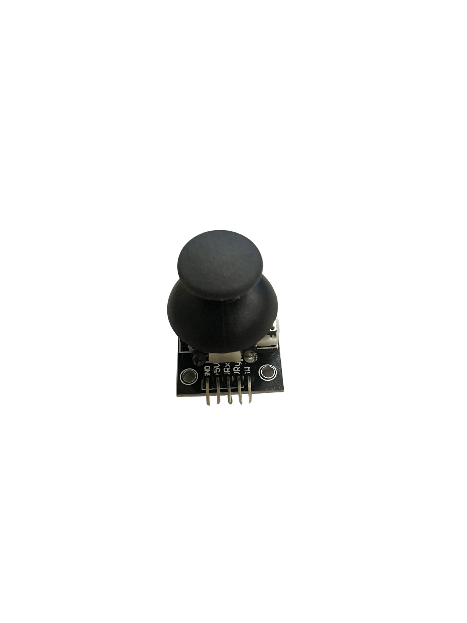
Component List
37 in 1 Sensor Kit: Joystick

Slide 8
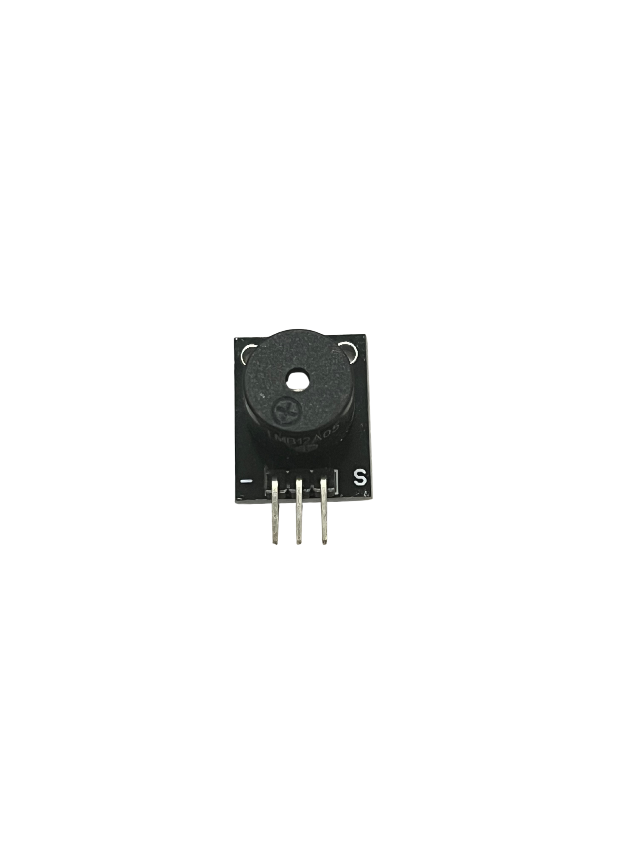
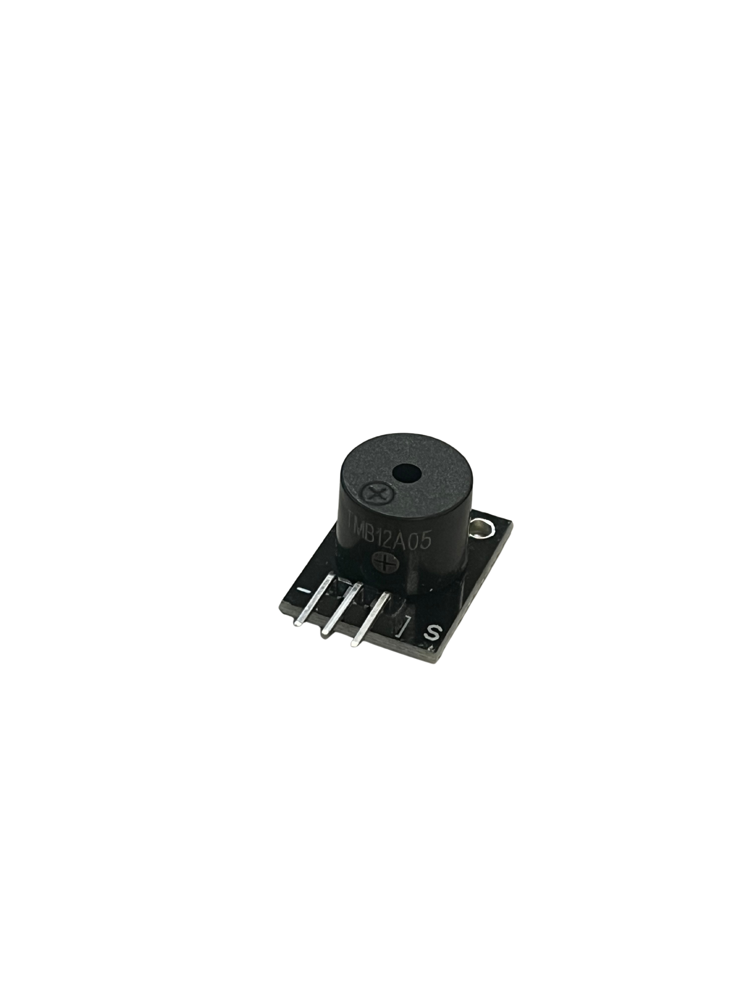
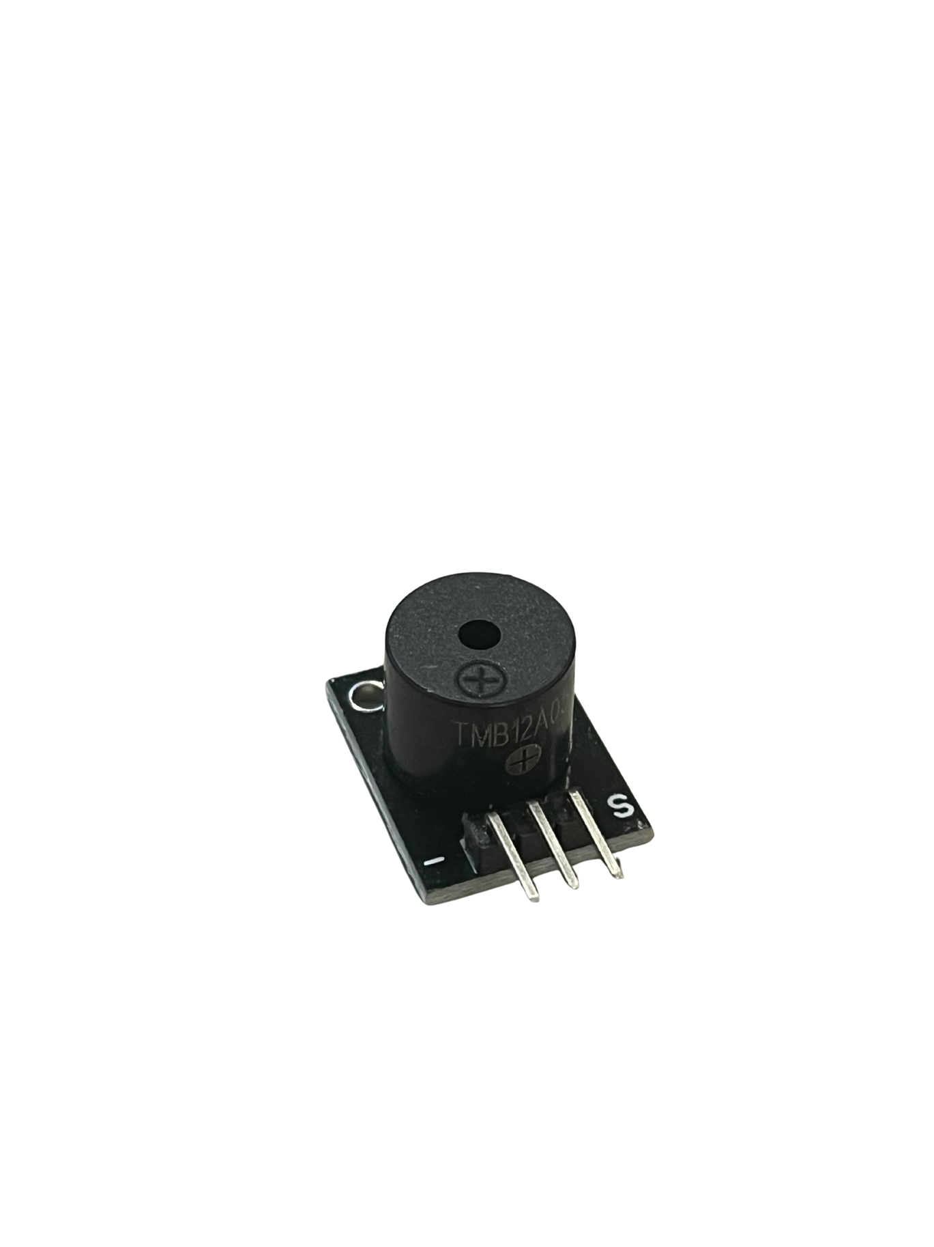
Component List
37 in 1 Sensor Kit: Passive Buzzer

Slide 9
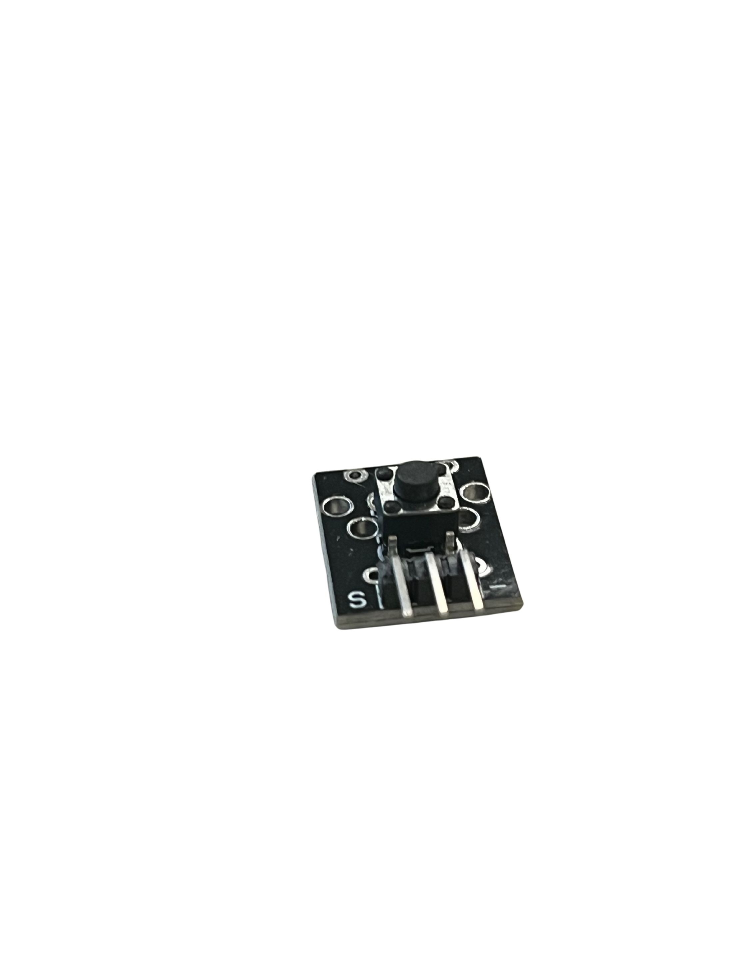
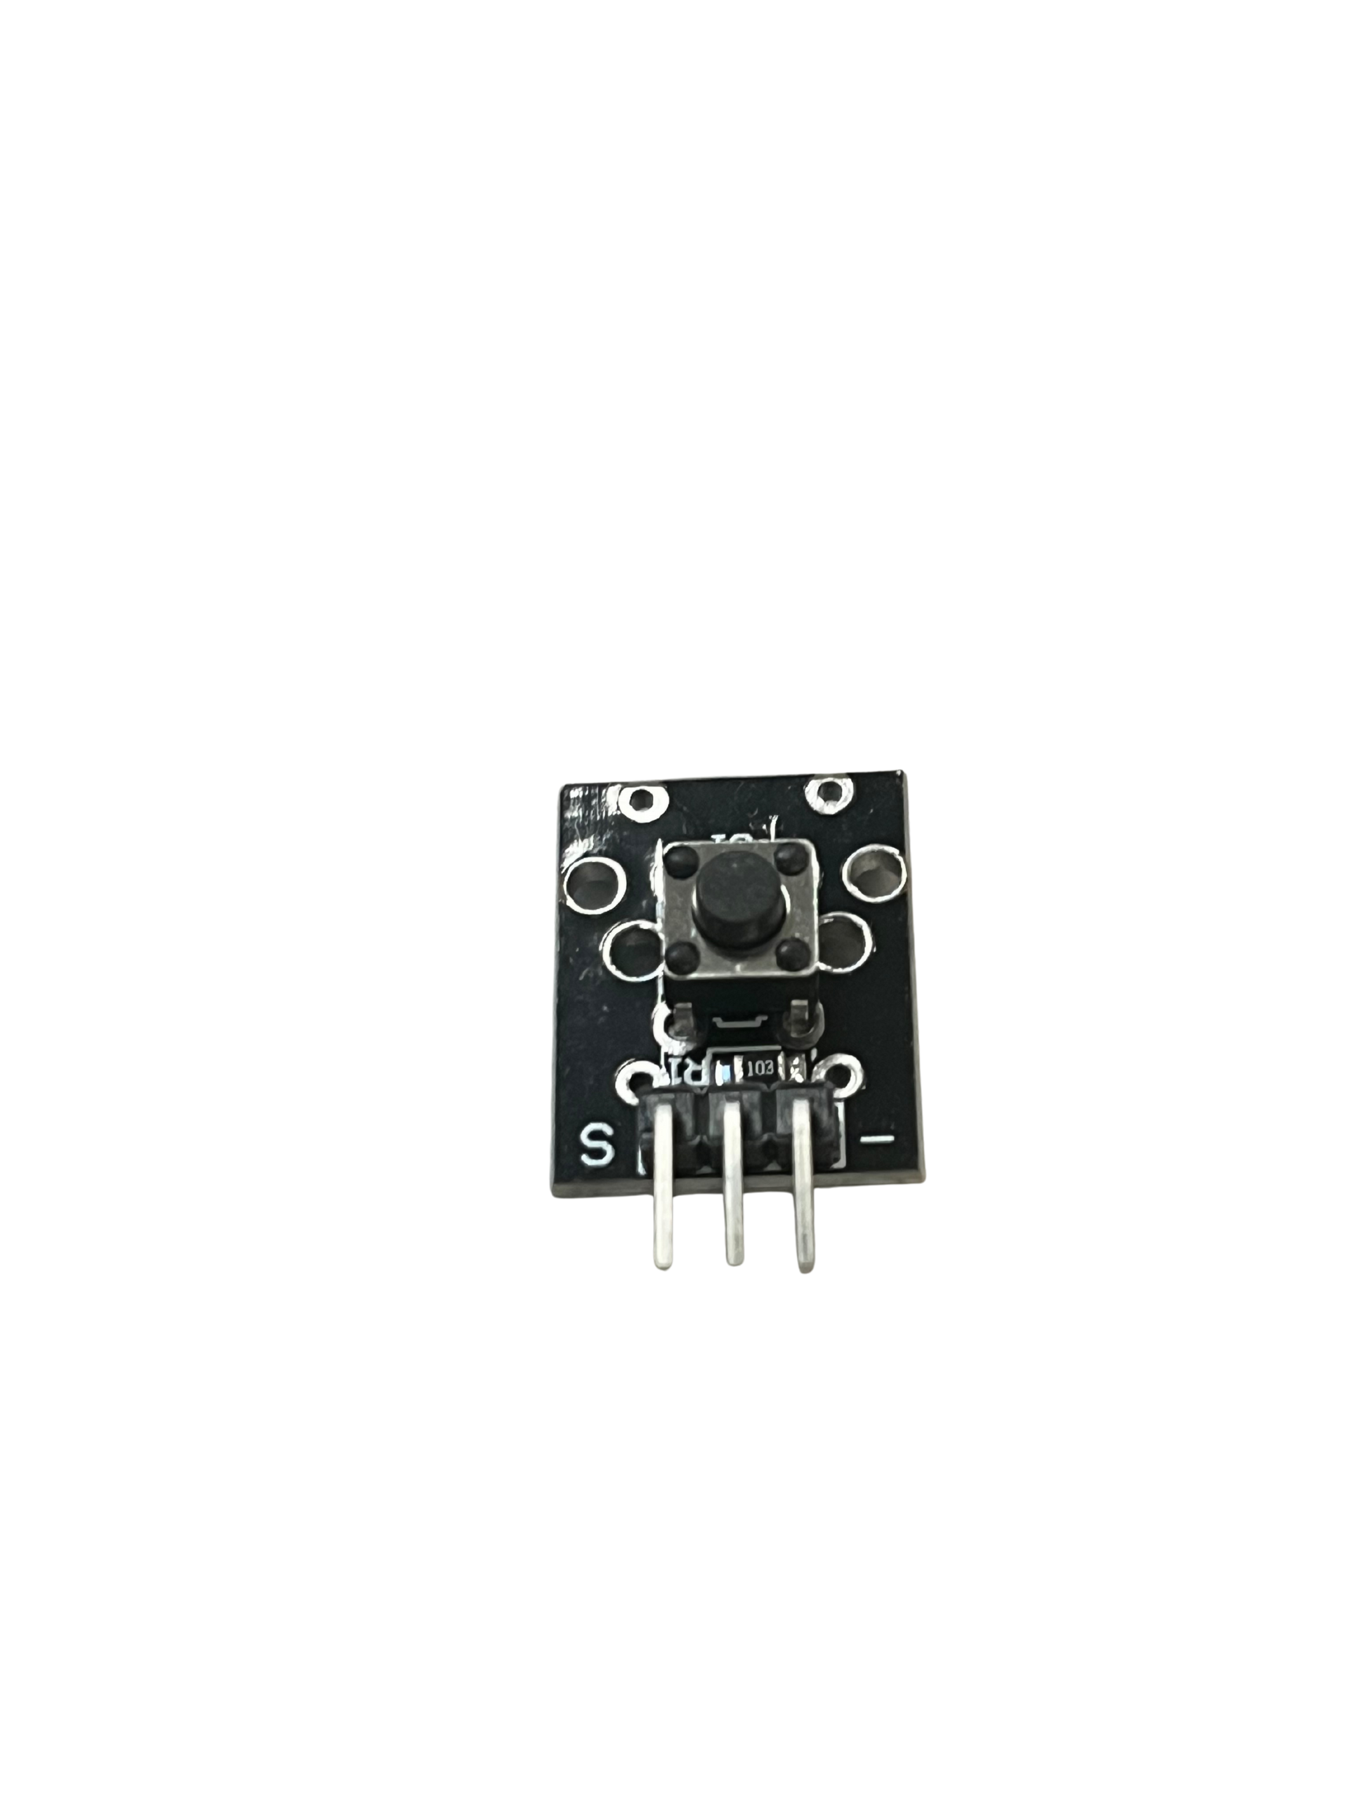
Component List
37 in 1 Sensor Kit: Button

Slide 10
Key Information
Powered by a Single AA Battery
Up to 30 Hours of Continuous Use
Rechargeable via USB-C
Accepts Input Directly or Remotely
Bi-Directional Morse Code Translation

Slide 11
Iterations of Device
Version 1:
Version 2:
Version 3:
Used only the onboard LED for displaying Morse. Supported only hard coded values for translation using a string inside of the code. Has no input system.
Added onboard LCD to display original character and Morse translation. Added capacitive touch buttons for onscreen keyboard to program values.
Added Passive Buzzer and Joystick. Buzzer plays audio in perfect sync with screen and LED while the joystick replaces the leftmost 4 capacitive touch buttons.
Version 4:
Version 5:
Version 6:
Added physical button for Morse input. Now supports input of morse and displays sentences on-screen.
Improved capabilities of software to support smoother, safer, and cleaner code. Removed unused functions, added more helpers, and overall made user experience much better.
Final Version: Added Web Server capabilities to allow changing of speed of outputs as well as sending a message to be translated. Allows typing on all devices, dictation, and any other method of input to control the output.

Slide 12


